Slide 1

Responsive emailer guidelines 2.1
No CTA (Call to Action) Disclaimer pop-ups
Mandatory UTM links
Text-based CTA buttons

Slide 2
Index
New Design 2.1
Components of emailer
What’s new?
No more CTA Disclaimer pop-ups
Text-based CTA buttons
UTMs in CTA (Call To Action) links
Emailer drafting guidelines
Quick brand guide
Character limits & suggestions
HTML coding guidelines
What do we mean by device-responsive?
JPEG designing is different from HTML coding
Cheat-sheet for designing JPEG
Cheat-sheet for coding in HTML
Detailed HTML coding guidelines
Touchpoints versions
Promotional vs Service communications
Mapped vs Unmapped base

Slide 3
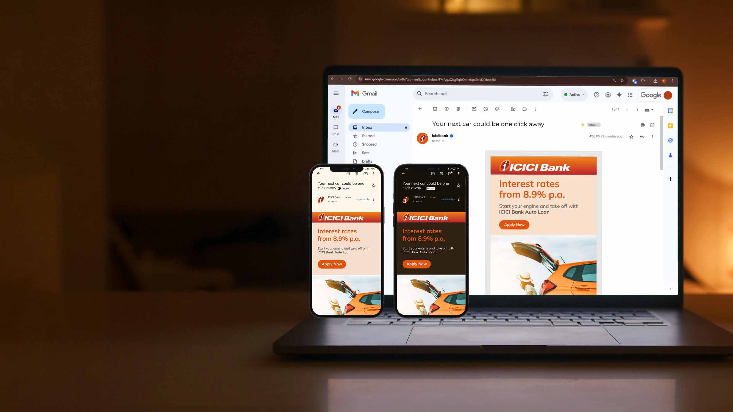
New Design 2.1

Slide 4
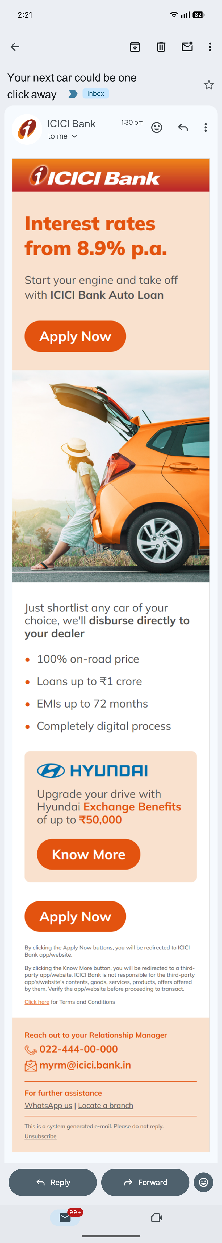
Components of emailer
Email body
Subject line
Logo band
Headline & Sub-headline
Second CTA
First CTA
Disclaimers &
T&Cs
Banner Image
Touchpoints

Slide 5
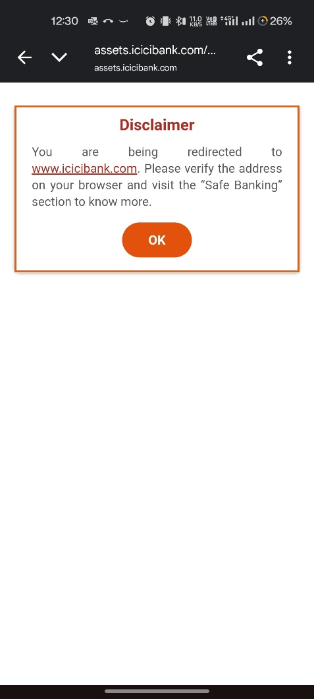
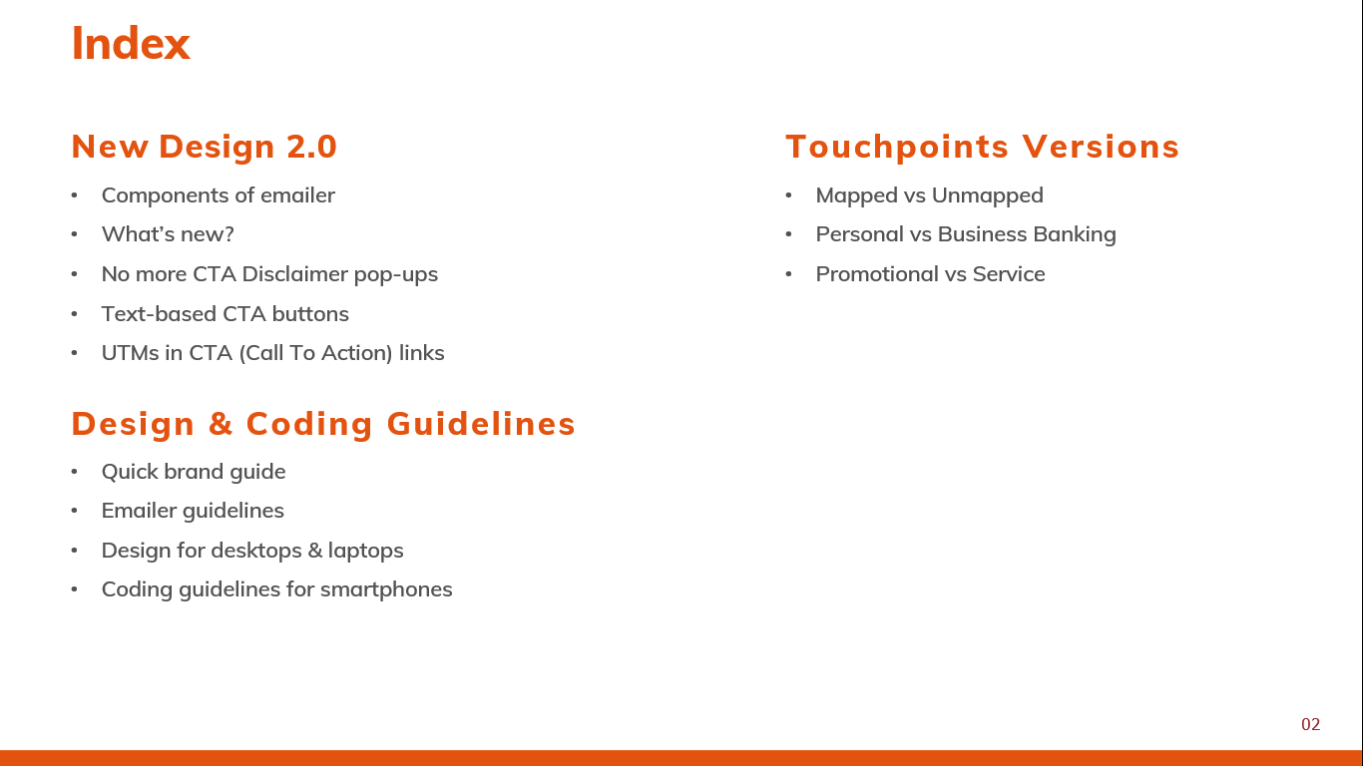
What’s new?
No more Disclaimer Pop-Ups
Text-based CTA buttons
Mandatory UTMs in CTA (Call To Action) links
4:18
⁺ 43%

Slide 6

No more CTA Disclaimer pop-ups
Benefits:
Customers directly land on the intended landing pages
No leakage in CTR (Click Through Rate)
First Party Disclaimer
Third Party Disclaimer
First Party Disclaimer
By clicking the <Apply Now> buttons, you will be redirected to ICICI Bank app/website.
Third Party Disclaimer
By clicking the <Know More> button, you will be redirected to a third-party app/website. ICICI Bank is not responsible for the third-party app's/website's contents, goods, services, products, offers offered by them. Verify the app/website before proceeding to transact.
Note:
Please update the disclaimer CTA button text to match the current CTA button (Example: Apply Now/Know More)
Notes:
Verify the app/website before proceeding with transaction.

Slide 7
Text-based CTA buttons
To make CTA buttons mobile-responsive, now the CTA buttons will be in text (editable) format instead of images.
Earlier code:
<tr>
<td align="left" style="padding: 0px; border: 0px;"><a href="local/ApplyNow.html" target="_blank"><img src="local/button.png" width="172" alt=“Apply Now"></a></td>
</tr>
New code:
<tr>
<td>
<table class="btn-table" role="presentation" border="0" cellpadding="0" cellspacing="0" align="left">
<tr>
<td align="left" bgcolor="#E3530F" style="background:#E3530F; border-radius:30px; padding: 12px 24px;">
<a href="https://buy.icicibank.com/ucj/AutoLoan?ius=COM31684ON&iup=UN1046AL" target="_blank" style="font-family: 'Mulish', Arial; font-size: 22px; line-height: 26px; color: #ffffff; text-decoration: none; display: inline-block; font-weight: 700;">Apply Now</a>
</td>
</tr>
</table>
</td>
</tr>

Slide 8
UTMs in CTA (Call To Action) links
Enable accurate campaign tracking & attribution by adding UTM parameters in CTA links.
UTM Generation form: https://icicibank-stage.adobecqms.net/revamp/utm
Important Notes:
The UTM embedded-link is mandatory. Any campaign without proper tagging will not be executed.
Ensure final URLs are within 255 characters
For support, contact Digital Channels Team: Rakesh Kumar (90109592@icicibank.com) / Raj Darra (90106298@icicibank.com)

Slide 9
Emailer drafting guidelines

Slide 10

Quick brand guide
Brand Logo
Brand Colours
Flat Orange | | | PANTONE 166C | | | C: 00 M: 75 Y: 100 K: 00 | | | R: 227 G: 83 B: 15 | | | #E3530F
Flat Maroon | | | PANTONE 7622C | | | C: 00 M: 98 Y: 77 K: 37 | | | R: 148 G: 41 B: 46 | | | #94292E
97281D
E3530F
F9E1CE
000000 525252 C6C6C6
D9D9D9
F2F2F2
FFFFFF

Slide 11
Quick brand guide
Mulish font family
Brand Fonts
Aa
Extralight: | ABCDEFGHIJKLMNOPǪRSTUVWXYZ abcdefghijklmnopqrstuvwxyz 0123456789 (.;:?!@#$%&*-)
Light: | ABCDEFGHIJKLMNOPǪRSTUVWXYZ abcdefghijklmnopqrstuvwxyz 0123456789 (.;:?!@#$%&*-)
Regular: | ABCDEFGHIJKLMNOPǪRSTUVWXYZ abcdefghijklmnopqrstuvwxyz 0123456789 (.;:?!@#$%&*-)
Medium: | ABCDEFGHIJKLMNOPǪRSTUVWXYZ abcdefghijklmnopqrstuvwxyz 0123456789 (.;:?!@#$%&*-)
Semibold: | ABCDEFGHIJKLMNOPǪRSTUVWXYZ abcdefghijklmnopqrstuvwxyz 0123456789 (.;:?!@#$%&*-)
Bold: | ABCDEFGHIJKLMNOPǪRSTUVWXYZ abcdefghijklmnopqrstuvwxyz 0123456789 (.;:?!@#$%&*-)
Extrabold: | ABCDEFGHIJKLMNOPǪRSTUVWXYZ abcdefghijklmnopqrstuvwxyz 0123456789 (.;:?!@#$%&*-)
Black: | ABCDEFGHIJKLMNOPǪRSTUVWXYZ abcdefghijklmnopqrstuvwxyz 0123456789 (.;:?!@#$%&*-)

Slide 12
Character limits & suggestions
Subject line (up to 50 characters):
Crisp subject lines lead to higher open rates in emailers
Hint towards the product being pitched in the first 4 words
Approximately 35 characters are visible in mobile inbox
Headline (up to 35 characters):
Clearly mention the main proposition of the product/service
Sub-headline (up to 60 characters):
Mention complete product name
Top CTA (up to 15 characters):
CTA text should be action-oriented
Use a UTM-embedded trackable CTA link

Slide 13
Character limits & suggestions
Banner image:
Add suitable ‘Alt description’ in HTML code for the banner image
Avoid writing copy on the banner image
Body copy:
No icons to be used in place of bullets

Slide 14
Character limits & suggestions
Repeated CTA (up to 15 characters):
Use the Same as Top CTA
1st Party & 3rd Party Disclaimers | T&Cs:
The copy and placement of Disclaimers and T&Cs are as per Legal team’s suggestions. Please use them as they are.
Only replace the name of your CTA button or link.
Touchpoints
Based on Promotional or Service communication
Based on Mapped or Unmapped base

Slide 15
HTML coding guidelines
(To make a device-responsive emailer )

Slide 16

What do we mean by device-responsive?
The same emailer looks different in Laptop and Mobile device.
The HTML file consists of ‘class’, which identifies your device.

Slide 17
What do we mean by device-responsive?
The same emailer looks different in Laptop and Mobile device.
The HTML file consists of ‘class’, which identifies your device.

Slide 18
JPEG designing is different from HTML coding
Your email client does not understand ‘Mulish Black/Bold’. It only understands base font (Mulish/Arial).
Hence, the font styles used while designing JPEG differ from the fonts required in the HTML

Slide 19
Cheat-sheet for designing JPEG

Slide 20
Cheat-sheet for coding in HTML
Sample HTMLs have been provided along with the guidelines
For consistency, it is recommended to use them without any altering any code.

Slide 21

Detailed HTML coding guidelines
Mailer width 320 px
50 px Logo band
30 px between Logo band and Headline
Headline | Mulish (Weight – 900) | Size: 32 px | Colour: #E3530F
Up to 35 Characters (including spaces)
Background Colour: #F9E1CE
20 px between Headline and Sub-headline
Sub-headline | Mulish (Weight – 400) | Size: 18 px | Colour: #525252
Up to 60 Characters (including spaces)
Highlighted Sub-headline: Mulish (Weight – 700) | Size: 18 px | Colour: #525252
CTA Button | Mulish (Weight – 700) | Size: 22 px | Colour: #FFFFFF
Up to 15 Characters (including spaces)
Note: CTA button is editable
30 px between Sub-headline and CTA
40 px CTA Button | Colour: #E3530F
30 px between CTA and Image
320 px width of image box
Image | Mention suitable ‘Alt Description’
Note: Logo, Content and CTA be left-aligned; only the text inside the button should be center-aligned.

Slide 22

Detailed HTML coding guidelines
Mailer width 320 px
30 px between image and body copy
20 px left and right edges email body
21 px line-height
Body Copy | Mulish (Weight – 400) | Size: 18 px | Colour: #525252 | Left Aligned
20 px between body copy and features
Bullet points | Mulish (Weight – 400) | Size: 18 px | Colour: #525252
15 px between each feature
30 px between body copy & third-party banner
Banner Background Colour: #F9E1CE
20 px between band & third-party logo
15 px between third-party logo & copy
Body Copy | Mulish (Weight – 400) | Size: 18 px | Colour: #525252 | Left Aligned
Highlighted Body Copy | Mulish (Weight – 700) | Size: 18px | Colour: #E3530F
CTA Button | Mulish (Weight – 700) | Size: 22 px | Colour: #FFFFFF
Up to 15 Characters (including spaces)
Note: CTA button is editable
20 px between copy & CTA
40 px CTA button radius | Colour: #E3530F
20 px between CTA & band
30 px between third-party banner & CTA
CTA Button | Mulish (Weight – 700) | Size: 22 px | Colour: #FFFFFF
Up to 15 Characters (including spaces)
Note: CTA button is editable
40 px CTA button radius | Colour: #E3530F
20 px between CTA & disclaimer
Note: Logo, Content and CTA be left-aligned; only the text inside the button should be center-aligned.

Slide 23
Detailed HTML coding guidelines
Mailer width 320 px
Disclaimer | Mulish (Weight – 400) | Size: 9 px | Colour: #525252 | Left Aligned
10 px between First Party & Third-Party Disclaimer
T&C Hyperlinked | Mulish (Weight – 400) | Size: 9 px | Colour: #E3530F
10 px between First Party & Third-Party Disclaimer
20 px between T&C and Touchpoints Band
20 px between Touchpoints Band & Copy
Touchpoints Header | Mulish (Weight – 400) | Size: 12 px | Colour: #E3530F
Phone, Email ID | Mulish (Weight – 700) | Size: 16 px | Colour: #E3530F
10 px between Copy & Divider
Touchpoints Content | Mulish (Weight – 400) | Size: 12 px | Colour: #525252
Do not reply | Mulish (Weight – 400) | Size: 9 px | Colour: #525252
10 px between Divider and Copy
Unsubscribe | Mulish (Weight – 400) | Size: 9 px | Colour: #525252
10 px between Content and Border
Note: Logo, Content and CTA be left-aligned; only the text inside the button should be center-aligned.

Slide 24
Touchpoints versions
(All sample templates are available in Universe)

Slide 25
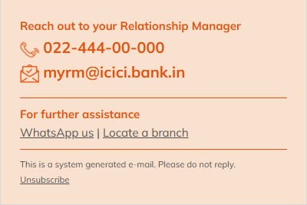
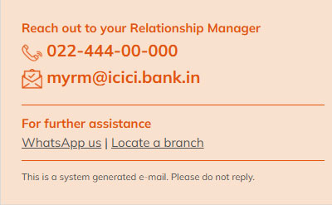


Promotional & Service communication
Salutation & Sign-off not to be included
Salutation and Sign-off required
Promotional
Service

Slide 26

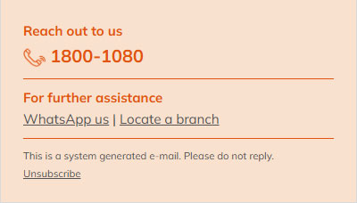
Mapped vs Unmapped base
Mapped
Unmapped

Slide 28
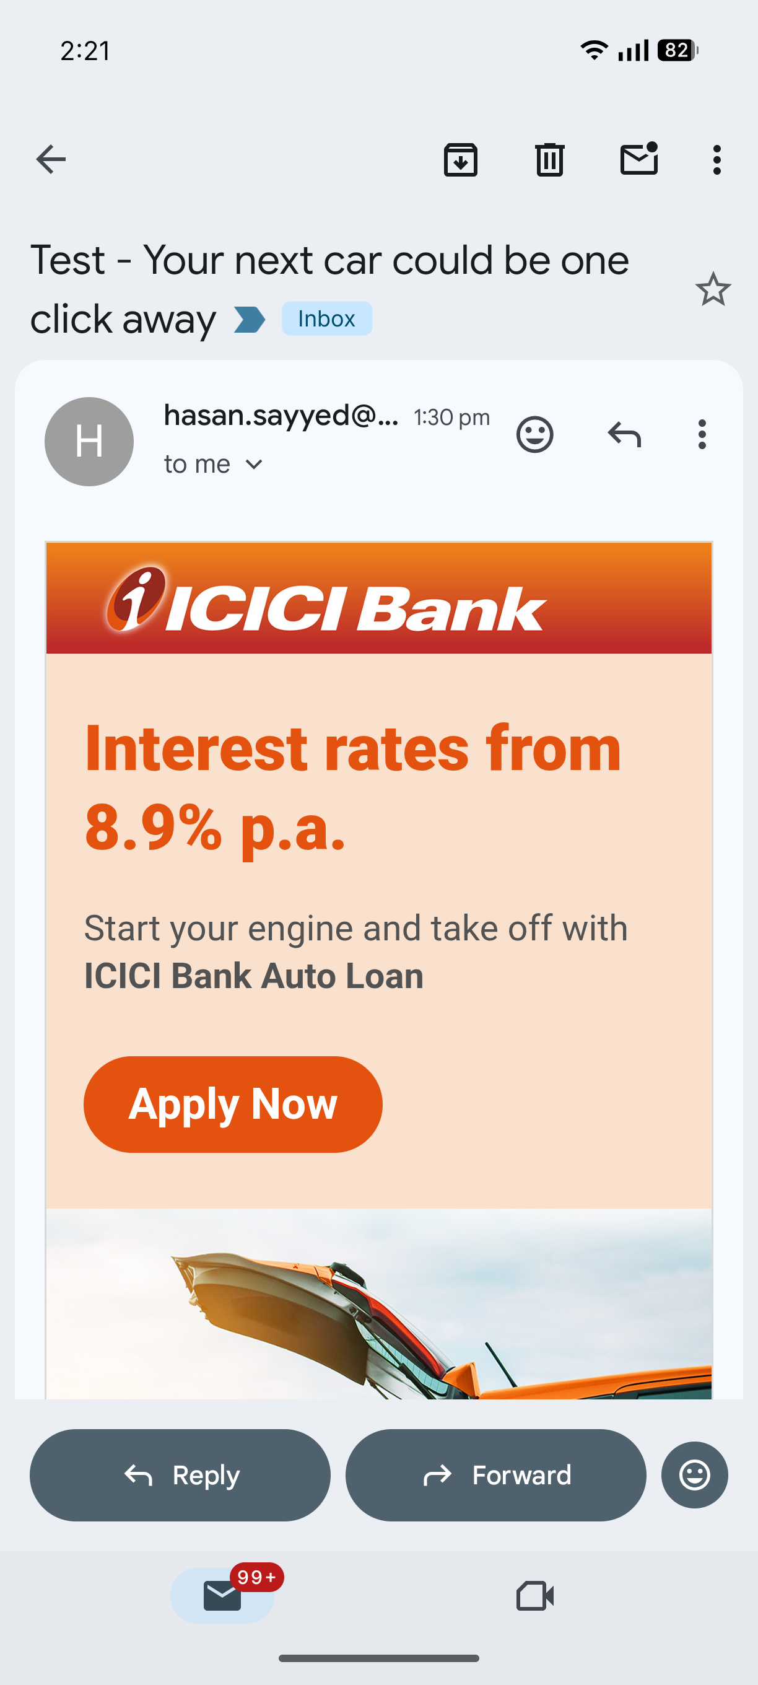

Your next car could be one
click away
ICICI Bank

